Slide 1
Development of Web-Based Piggery Management System for Sparkling Agro Farm
Nomer D. Sunga | Nathaniel DC. Teria
Jo-mar A. Macaraeg | Meco P. De Mayo
Mr. Renel F. Dumlao
Ms. Maria Regina M. Pablo | Mr. Bryan Paul D. Danganan

Slide 2
Motivation
Decision Making
Lack of data analysis
Slow transaction for Customer Service
Editing problems
Data Safety and Security Issues

Slide 3
Background
Web-Based system
CRUD (Create, Read, Update, and Delete)
Data Representation
Reports Production
Data Management
Decision Support

Slide 4
Objectives
The main objective of the study is to develop a “Web-Based Piggery Management System for Sparkling Agro Farm”.

Slide 5
Objectives
Specifically, the study aims to achieve the following objectives:
To develop a web-based piggery management system with the following components:
Auto-generated ID for the User.
Interface for login, signup, and logout.
Interface to reset password with OTP verification code.
d) Data Representation on a pie graph of the total number of pigs in different pens

Slide 6
Objectives
e) Interface to Create, Read, Update, and Delete (CRUD) for the following:
e.a. Fattener, Farrowing, Breeding, Piglet, Quarantine, Mortality, Feeds,
Expenses, and Income Records.
f) Interface to forecast the price of pig and export it to a pdf file,
g) Interface to update their photo and username.
h) Cross-Device Compatibility

Slide 7
Objectives
2. To evaluate the proposed IT Solution based on ISO 9126 through end-users in terms of:
a. Usability
b. Functionality

Slide 8
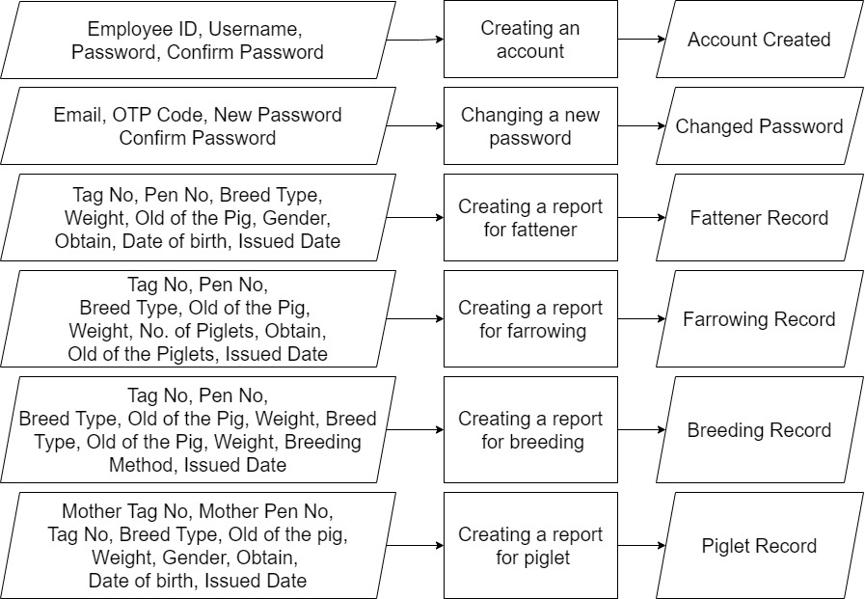
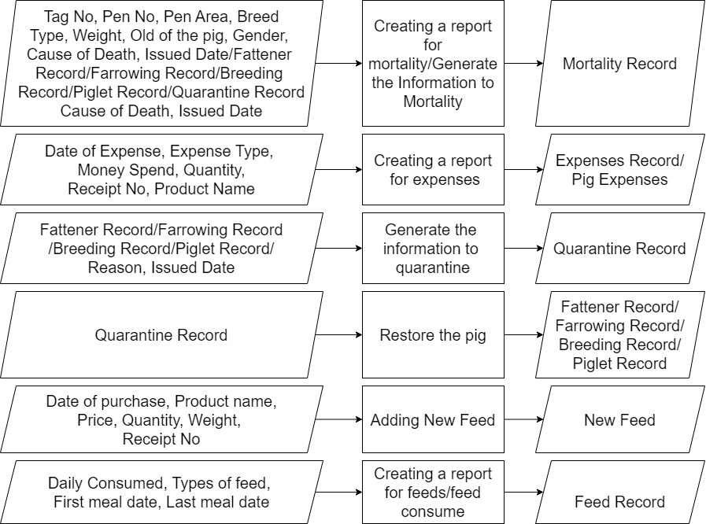
IPO of User
1
2

Slide 9
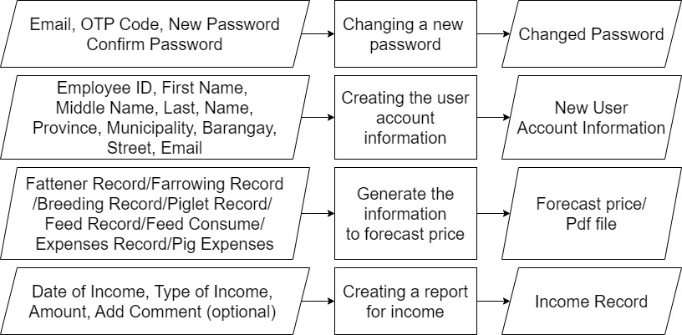
IPO of Administrator

Slide 10
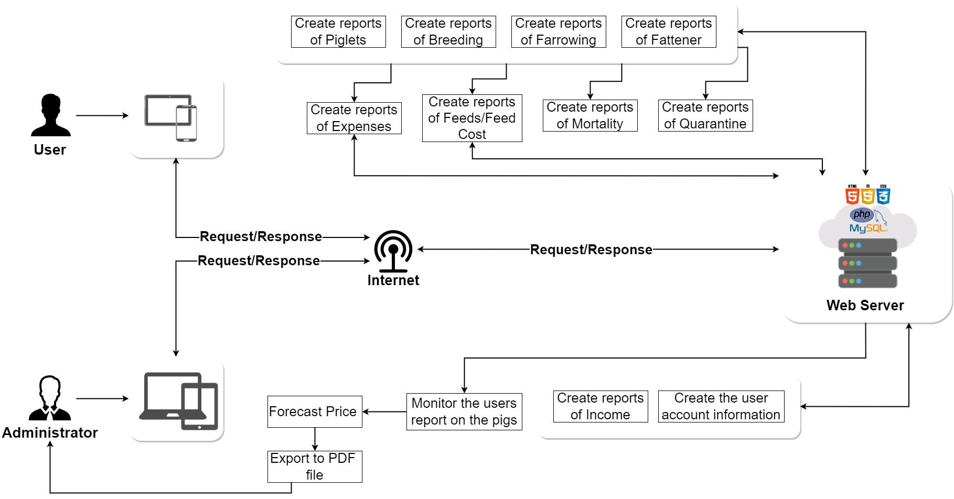
System Architecture

Slide 11
Video Presentation
The video will be presented…

Slide 12
Thank you

